Slide 1



CAPSTONE PROJECT PRESENTATION
Free Sewaa
Community Donation & Resource-Sharing Platform
"Connecting Givers with Those in Need"

Slide 2


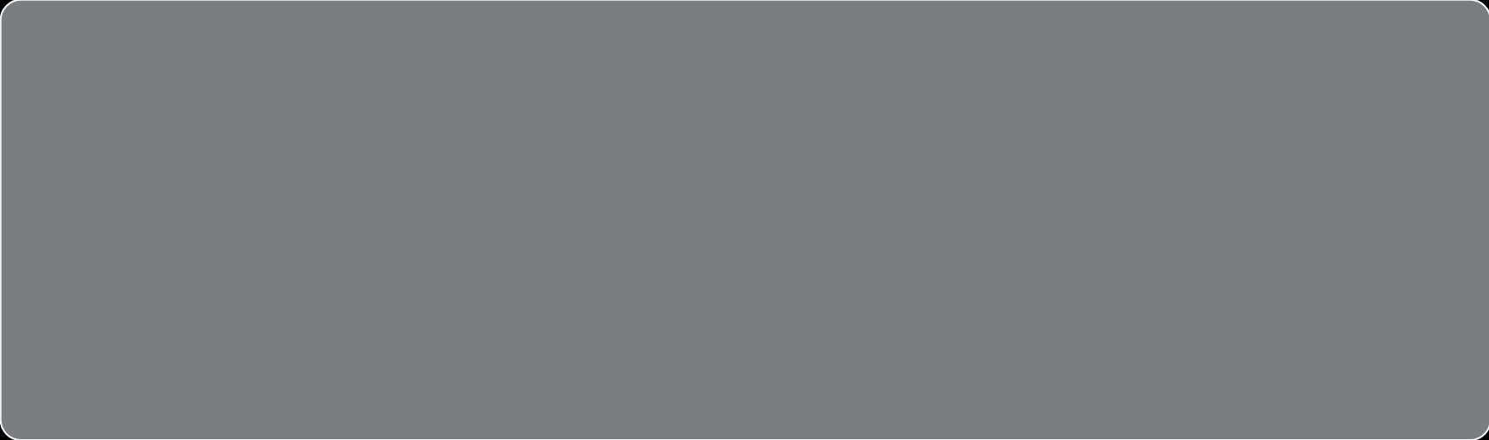





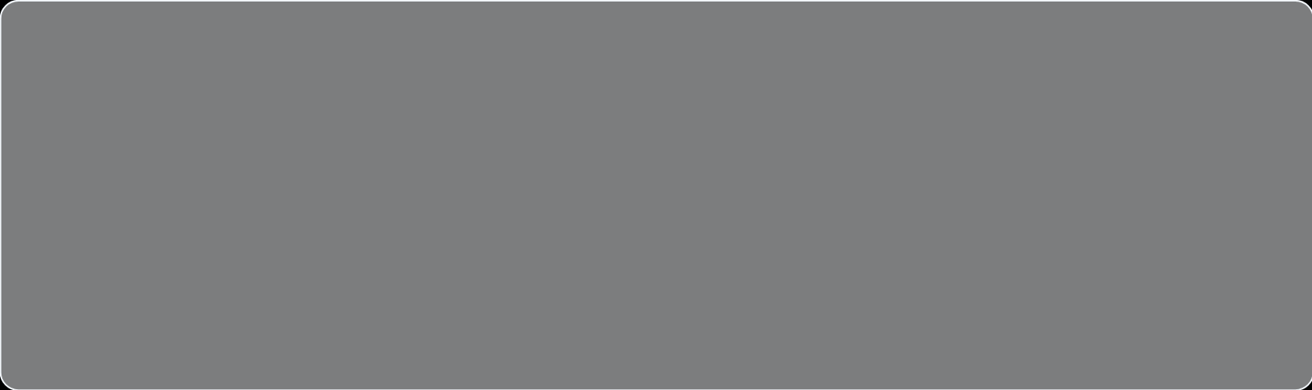





Introduction to Free Sewaa
A community-driven web platform designed to connect givers with those in need, fostering a culture of generosity and sustainability.
Promote Sustainability
Community Support
Encouraging the reuse of usable items to reduce local household waste and environmental impact.
Assisting students and low-income individuals by providing free access to essential resources.
Bridge the Gap
Community-First Approach
Creating a seamless digital link between generous donors and community members in need.
A dedicated platform focused purely on free item sharing rather than commercial transactions.

Slide 3


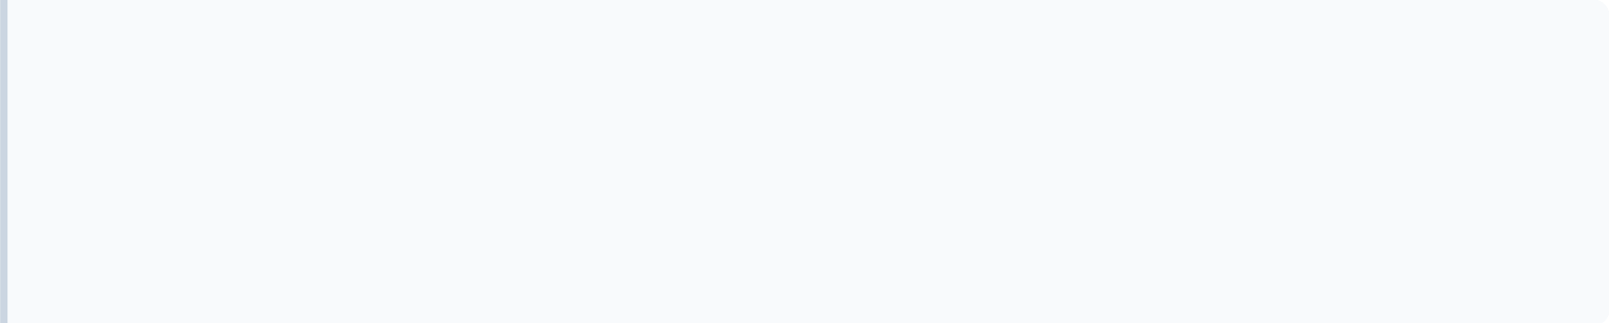




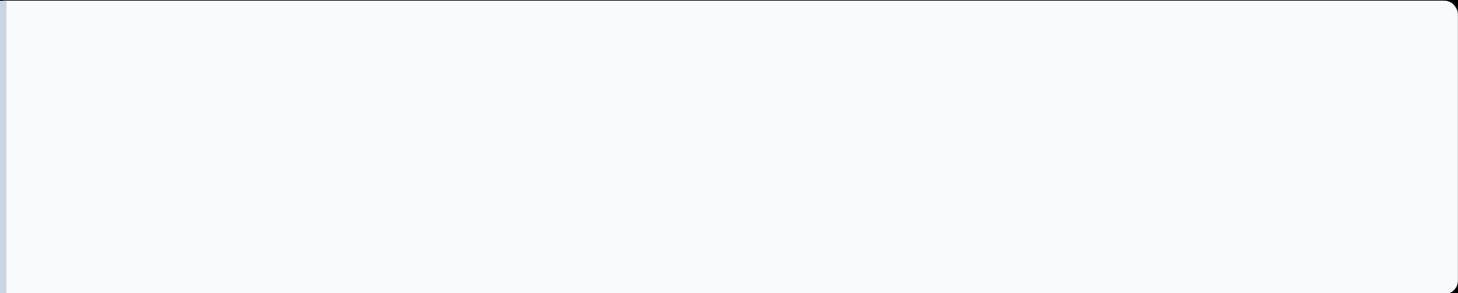




Problem Statement
The gap between abundance and necessity
The Central Issue:
Usable items are discarded while vulnerable community members struggle to afford basic necessities due to the lack of a centralized, non-commercial sharing platform.
Environmental Waste
Economic Barrier
Perfectly usable household items end up in landfills unnecessarily because donation is "too difficult."
Students and low-income families often cannot afford essential goods like textbooks or furniture.
Information Gap
Commercial Noise
No centralized local platform exists to find free resources or notify donors of nearby needs.
Existing platforms (Marketplace) prioritize commerce, burying free listings under paid advertisements.
"A community's surplus should be its neighbor's solution."
WASTE REDUCTION
SOCIAL EQUITY

Slide 4






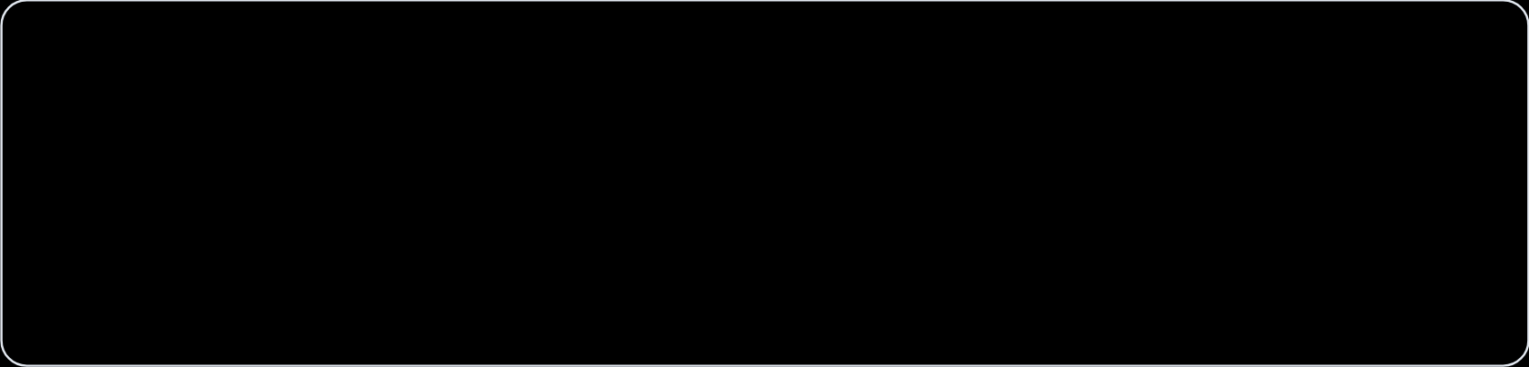
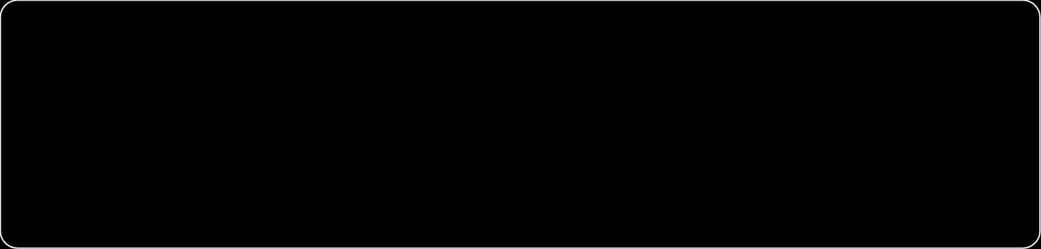



Proposed Solution
A Centralized Digital Hub for Community Generosity
Post Donations
Browse & Search
Easily list usable items with descriptions and photos to reach local neighbors.
Discover available resources nearby using smart categories and filters.
Request Items
Direct Coordination
Empower receivers to actively seek specific essentials they currently need.
Secure messaging system to arrange safe pickups and drop-offs.
100% Free Platform
No-Commerce Focus
Community Driven

Slide 5


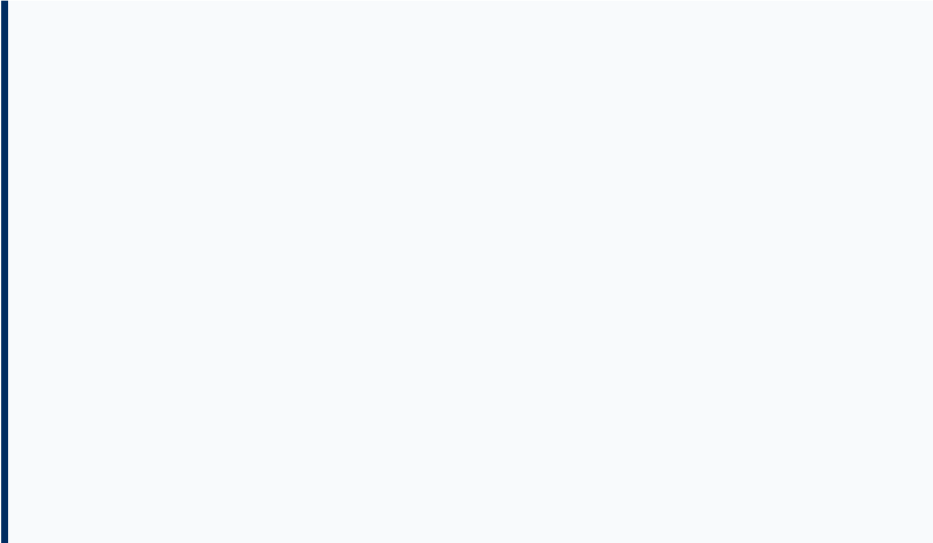







Project Objectives
Defining the mission and goals of the Free Sewaa platform.
Functional Platform
Core Interactions
Direct Communication
Develop a robust web-based donation platform for community resource sharing.
Enable users to seamlessly post, browse, and request donated items for free.
Facilitate efficient dialogue between donors and receivers for item collection.
Waste Reduction
Community Support
Intuitive Interface
Promote sustainability and reuse to decrease local household waste levels.
Provide essential goods to students and low-income families at no cost.
Deliver a clean, accessible, and user-friendly experience for all skill levels.
FREE SEWAA: CAPSTONE 2026
COMMUNITY & SUSTAINABILITY

Slide 6

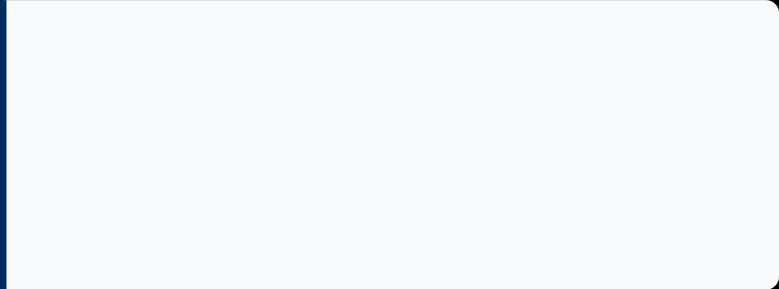
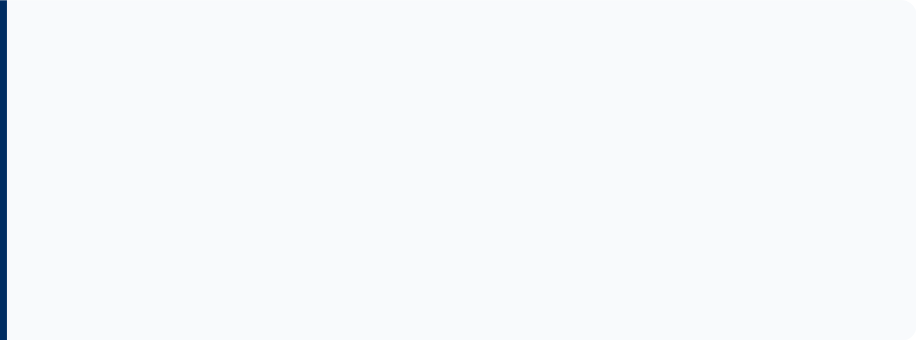




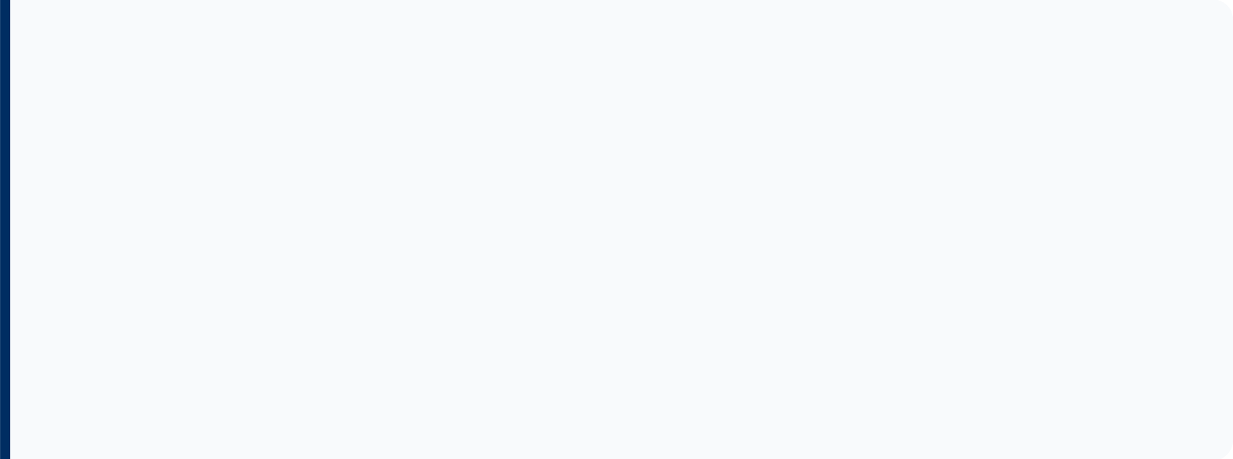
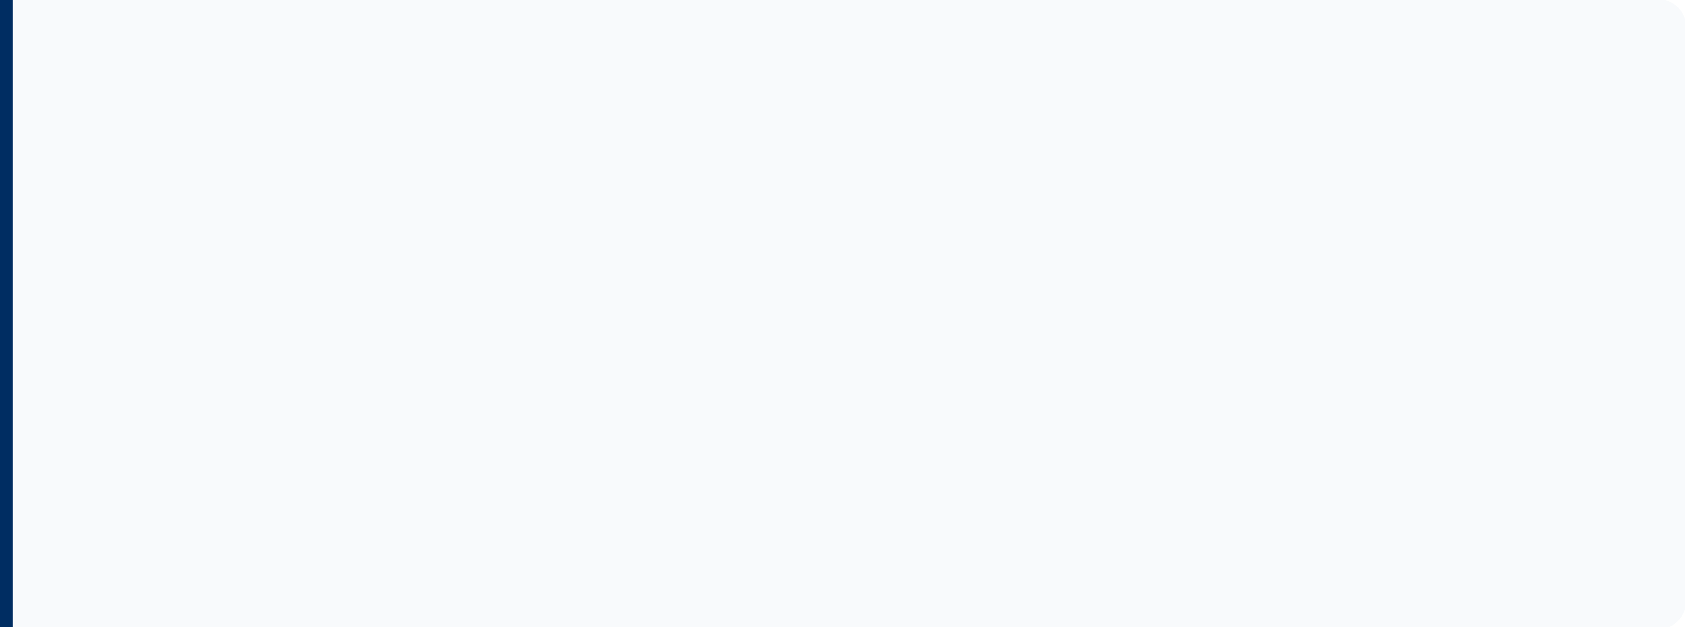




Target Users
Identifying our primary community stakeholders
Students
Low-Income Individuals
• Access to textbooks and study aids
• Seeking free essential goods
• Affordable furniture and kitchenware
• Reducing financial burden
• Support for campus living needs
• Access to household necessities
Responsible Donors
Community Members
• Wanting to give away usable items
• Participation in sustainable sharing
• Promoting reuse over waste
• Strengthening local connections
• Supporting local social causes
• Reducing neighborhood waste
FREE SEWAA PLATFORM

Slide 7

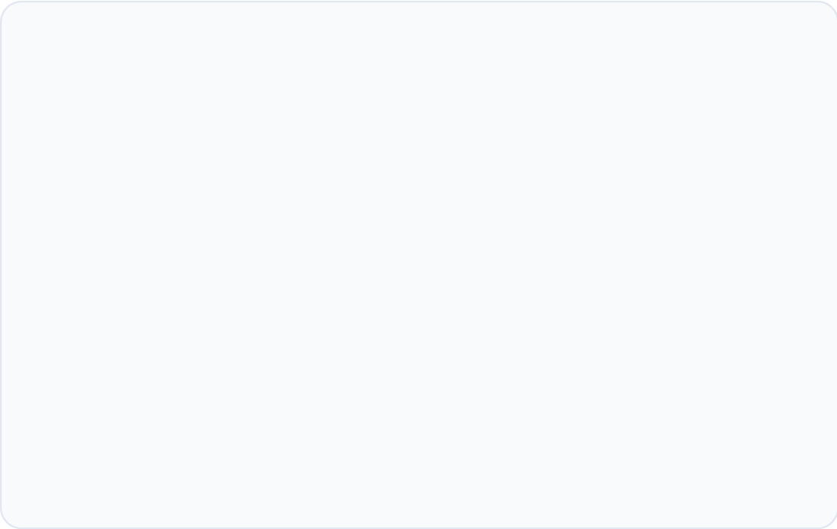
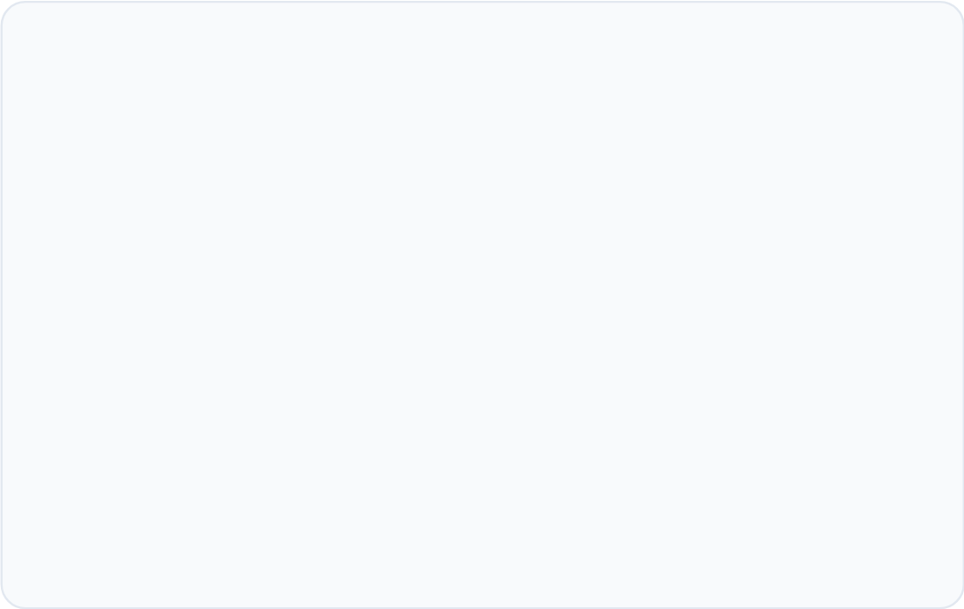







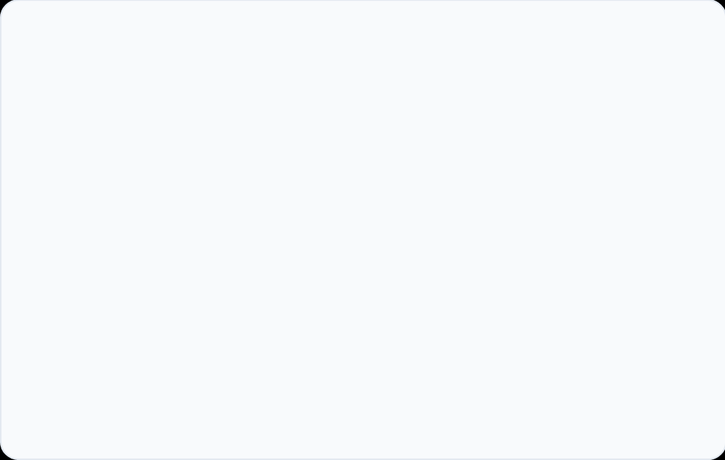
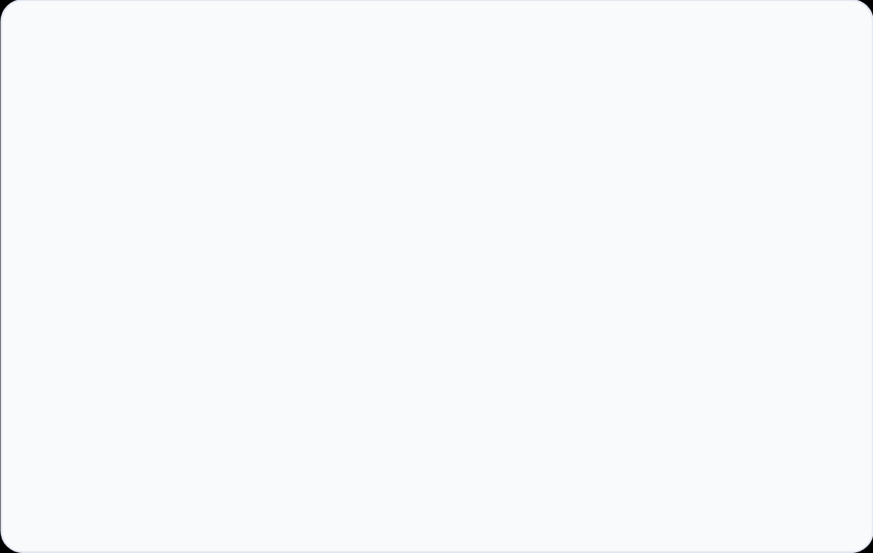







Key Platform Features
Secure Authentication
Item Posting
Browse & Search
Robust registration and login system for secure account management.
Simplified form to list donations with photos and descriptions.
Searchable and filterable grid view of all available community items.
Request System
Direct Communication
Intuitive Interface
Enables users to actively request specific essential goods they need.
Integrated messaging system to arrange pickups and exchange details.
Clean, responsive, and accessible design for all user demographics.
FREE SEWAA PLATFORM
Core Functionalities

Slide 8

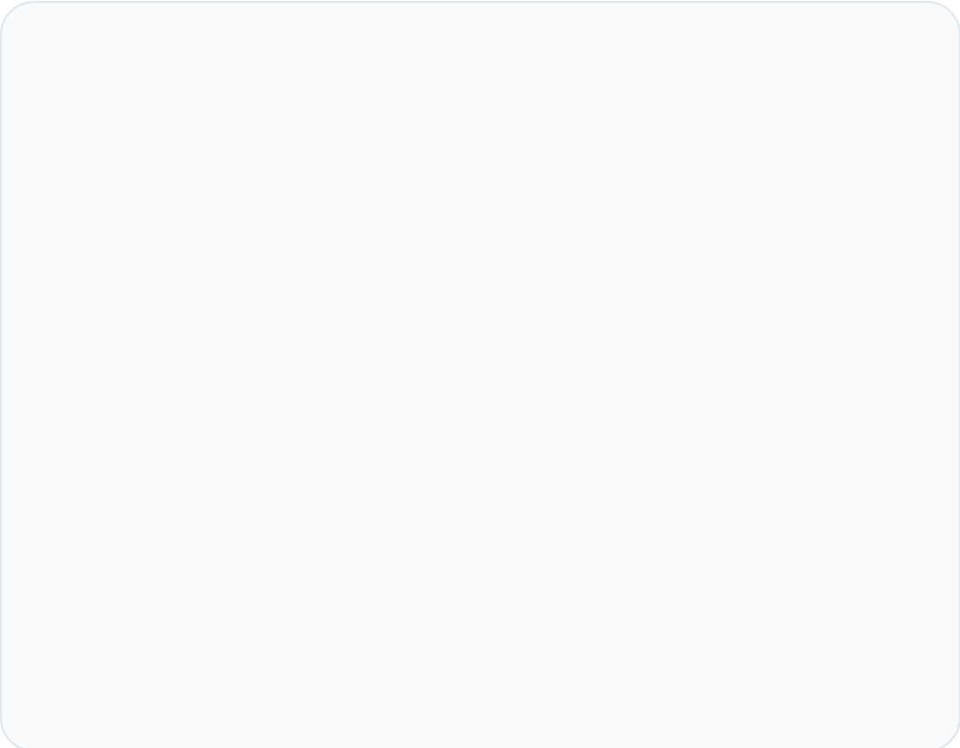
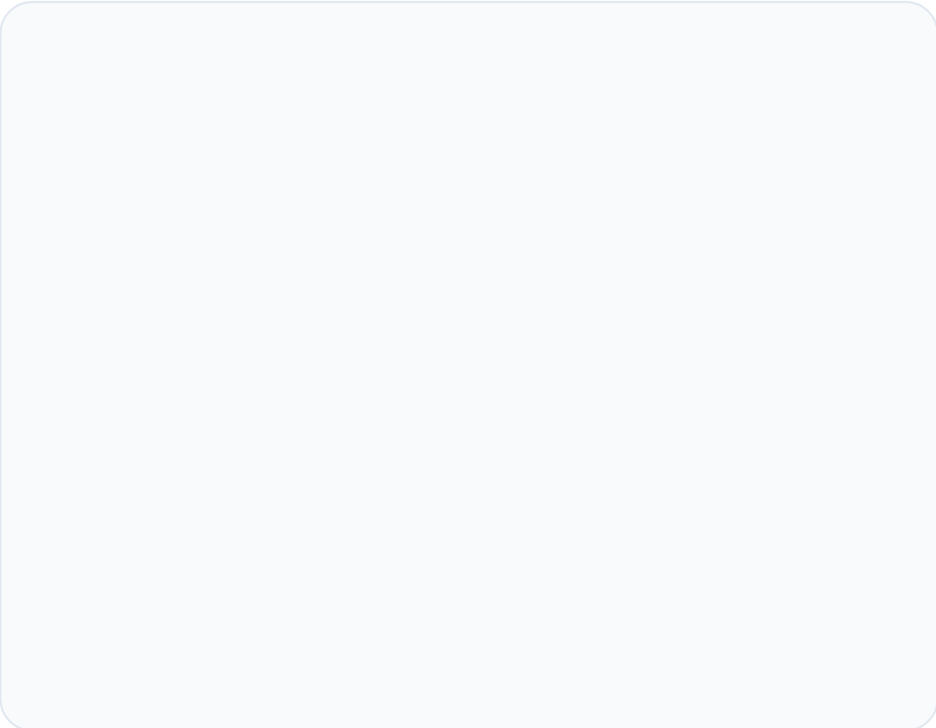
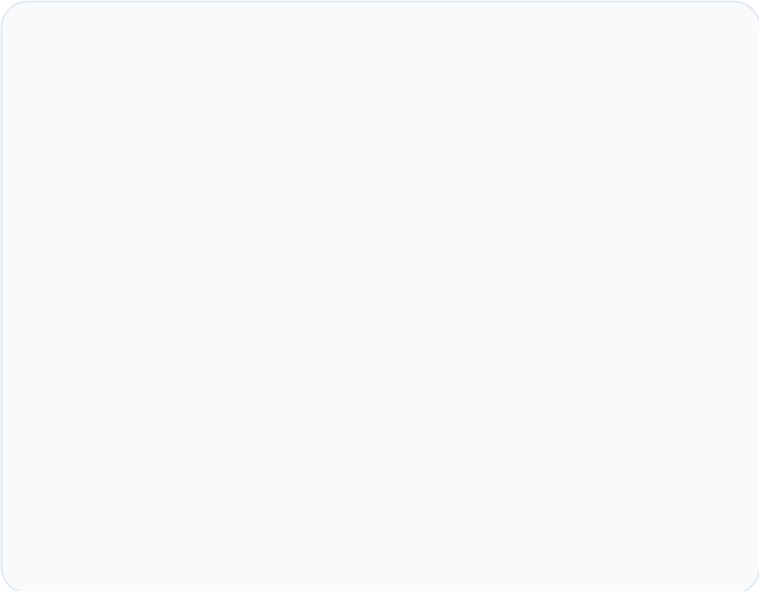







System Architecture
A Robust Three-Tier Web Framework
Presentation Layer
Application Layer
Data Layer
React.js
Node.js / Express.js
MongoDB / MySQL
Responsive UI components
RESTful API endpoints
User profile storage
Client-side routing
User authentication (JWT)
Item listing management
Dynamic state management
Business logic processing
Messaging data persistence
User Interaction
Frontend (React)
REST API (Node/Express)
Database Storage
SYSTEM LOGIC & DATA FLOW

Slide 9

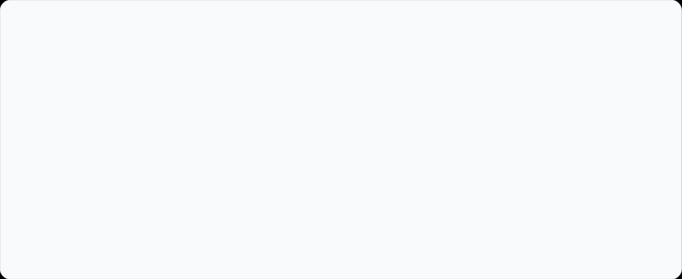











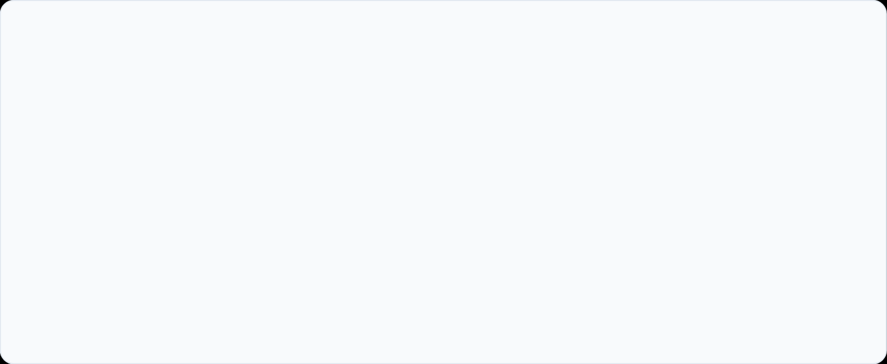
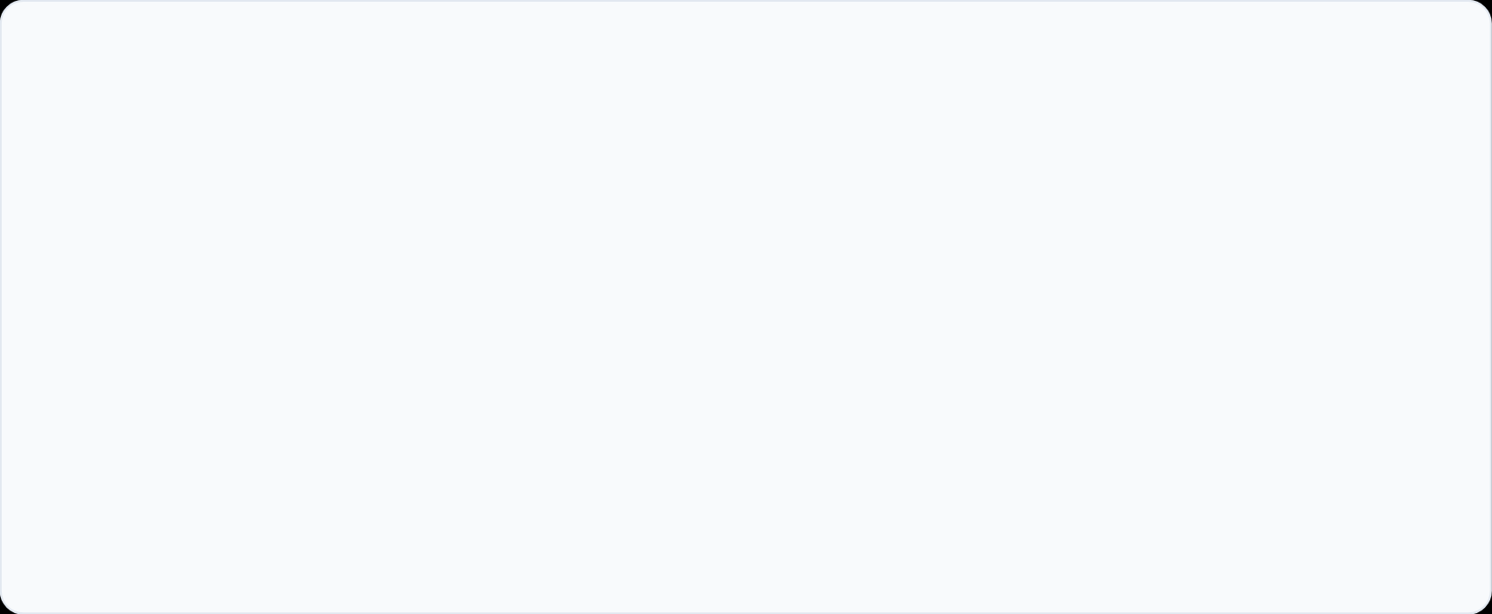










Technology Stack
FRONTEND
BACKEND & DATA
React.js
Node.js / Express.js
HTML5 / CSS3
MongoDB / MySQL
JavaScript (ES6+)
REST API Architecture
DEV TOOLS
DEPLOYMENT
GitHub(Version Control)
Vercel(Frontend)
Postman (API Testing)
Render(Backend)
Figma (UI/UX Design)
Continuous Integration
FREE SEWAA | MODERN TECH STACK

Slide 10










UI & Interface Design
A clean, professional blue-and-white themed visual experience.
Homepage & Nav
Item Listing Grid
User Dashboard
Centralized search bar for quick item discovery.
Responsive grid view with large photo previews.
"My Listings" panel for managing donations.
Featured donation highlights on landing.
Category tags (Furniture, Books, etc.) for filtering.
Integrated messaging for donor communication.
Intuitive top-level navigation menu.
Clear availability status indicators.
Request history and status tracking.
DESIGN PRINCIPLES
Clean Typography
High Contrast
Intuitive Flow

Slide 11





















Project Workflow
The structured development lifecycle of Free Sewaa
PHASE 01
PHASE 02
PHASE 03
PHASE 04
Requirements
UI/UX Design
DB Schema
Frontend
Scope definition & needs analysis
Figma wireframes & mockups
Data structure & relations
React component building
PHASE 05
PHASE 06
PHASE 07
PHASE 08
Backend API
Integration
Deployment
User Testing
Node/Express logic
System testing & debugging
Vercel & Render hosting
Feedback & final polish
TECH ECOSYSTEM:
GitHub
Figma
Postman
Iterative Development Methodology

Slide 12













Current Progress
Development Status & Implementation Roadmap
Completed
In Progress
Upcoming
Project Planning & Scope
Browse & Search Logic
Full Integration Testing
UI/UX Wireframing
Item Request System
Production Deployment
Database Schema Design
In-app Messaging Feature
User Acceptance Testing
User Auth (Login/Reg)
Item Posting Form
Overall Implementation
75%
Current Phase: Development & Integration
FREE SEWAA PROJECT MILESTONE 4

Slide 13

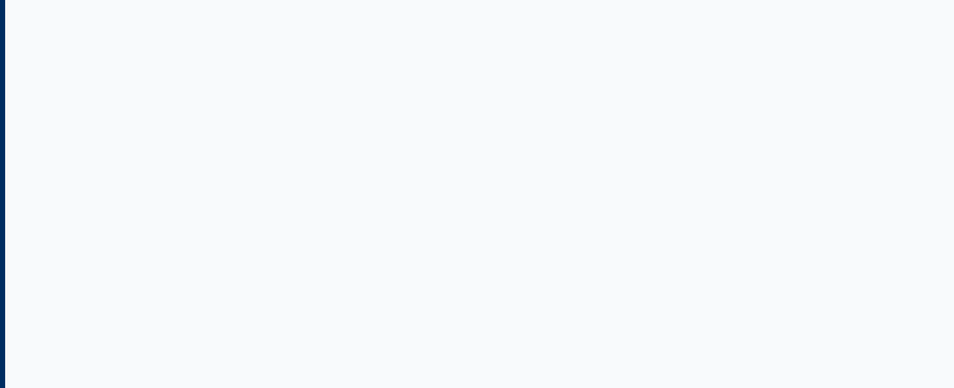













Challenges & Mitigations
User Adoption
Item Verification
Encouraging initial community engagement and platform usage.
Ensuring donated items are in usable and safe condition.
Mitigation: Rating system and clear photo requirements.
Mitigation: Targeted outreach to student groups & social media.
Real-Time Chat
Platform Security
Implementing reliable communication between donors/receivers.
Protecting user data and preventing platform misuse.
Mitigation: JWT authentication & data encryption protocols.
Mitigation: Using Socket.io for efficient message delivery.
ADDRESSING OBSTACLES FOR GROWTH
Free Sewaa | Capstone 2026

Slide 14

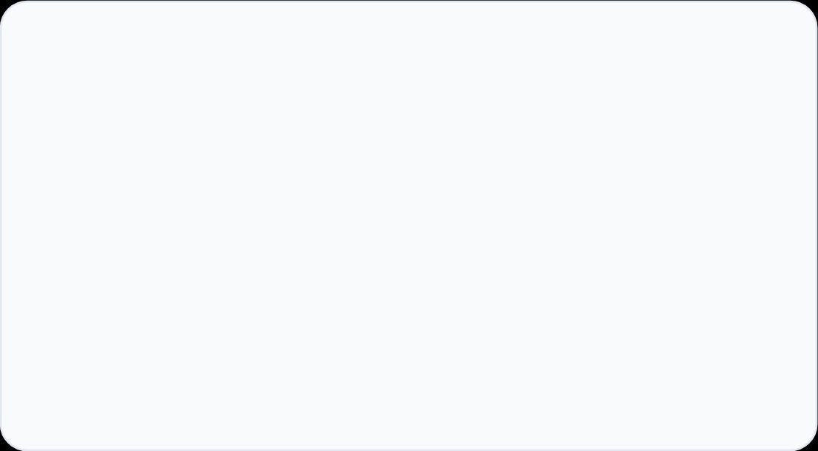
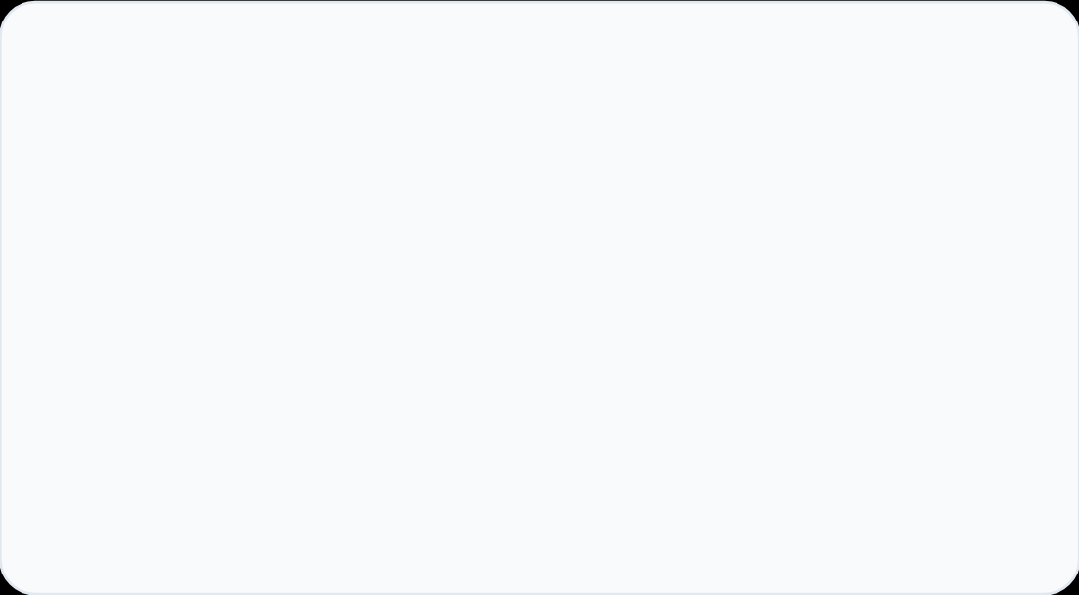
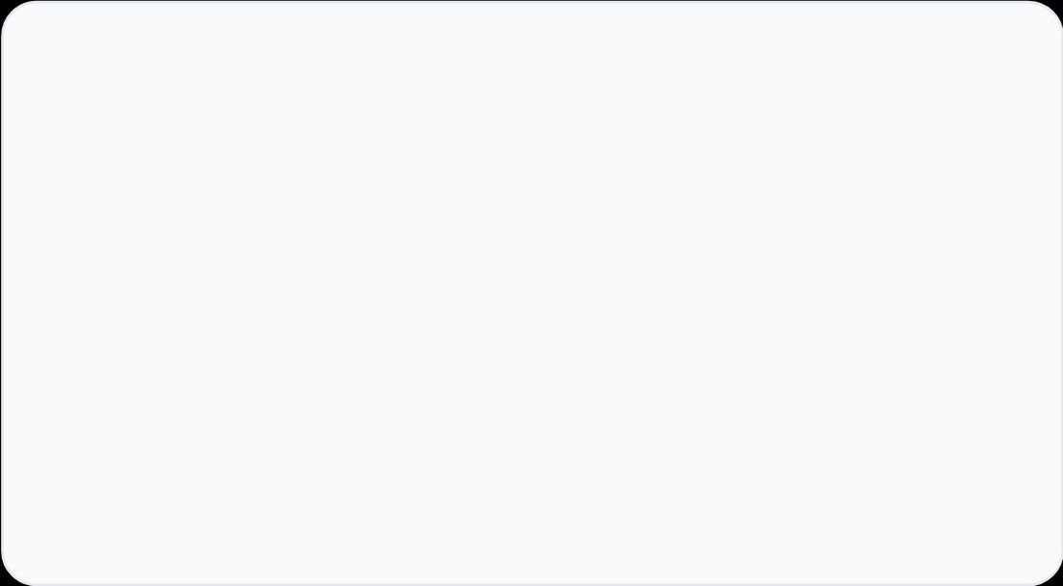






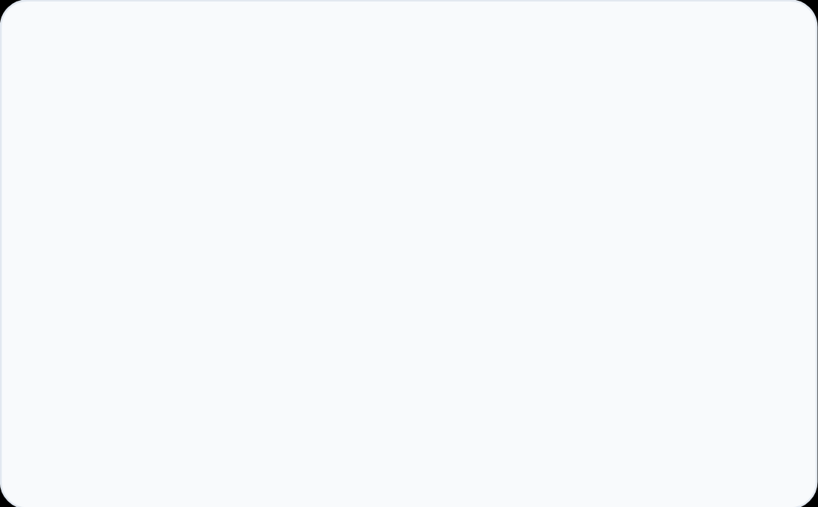








Future Improvements
A roadmap of planned enhancements to expand Free Sewaa's reach, intelligence, and accessibility.
Geolocation Integration
Push Notifications
Mobile Application
Display nearby donations based on the user's real-time location for faster pickups.
Alert users instantly when new items matching their interests become available.
Expand platform access with native iOS and Android apps for on-the-go usage.
AI-Based Recommendations
Multi-Language Support
Donor Rating System
Deliver personalized item suggestions to users based on their browsing and request history.
Make the platform inclusive and accessible to diverse communities across languages.
Build community trust through verified user reviews and transparent donor ratings.
CAPSTONE PROJECT2026

Slide 15





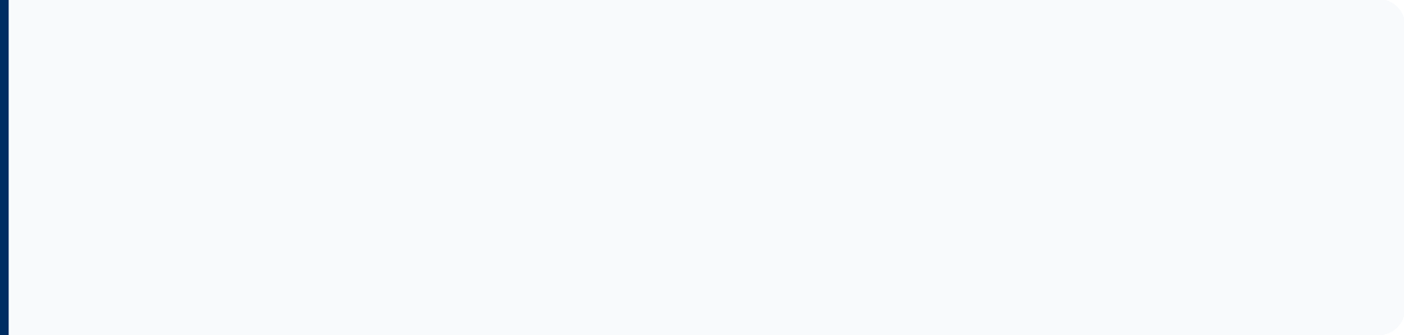



Conclusion
Social Responsibility
Addresses real community needs by providing a free, accessible platform for essential goods distribution.
Environmental Impact
Promotes sustainability and waste reduction by facilitating the reuse of household items.
Thank You!
Questions & Discussion
Technical Execution
Demonstrates full-stack proficiency using modern, scalable web technologies (MERN/MySQL).
"Connecting Givers with Those in Need"
FREE SEWAA CAPSTONE

